Slide 1
Digital Portfolio
STUDENT NAME:Tharani.E
REG NO : 2422k2190
NM I'D : A64AD3838485C9A8AB64795EF6A859D5
COLLEGE : PURATCHI THALAIVI AMMA GOVERNMENT ARTS AND SCIENCE COLLEGE, PALLADAM .
UNIVERSITY: BHARATIAR UNIVERSITY

Slide 2
PROJECT TITLE
DIGITAL PORTFOLIO

Slide 3


AGENDA
Problem Statement
Project Overview
End Users
Tools and Technologies
Portfolio design and Layout
Features and Functionality
Results and Screenshots
Conclusion
Github Link
3/21/2024 Annual Review

Slide 4

PROBLEM STATEMENT
Students often struggle to present their academic achievements, skills, and projects in a structured and professional manner. Traditional resumes fail to capture creativity, practical skills, and hands-on experiences, making it difficult for students to stand out in academic or career opportunities. There is a need for a digital portfolio solution that allows students to effectively showcase their competencies, projects, and growth.

Slide 5

PROJECT OVERVIEW
By developing this portfolio system, students will have a personalized digital identity that goes beyond a traditional CV, enhancing their chances of securing opportunities in competitive environments. It will also provide academic institutions and recruiters with a reliable and holistic view of a student’s potential

Slide 6

WHO ARE THE END USERS?
PRIMERY END USERS: Students
SECONDARY END USERS : Employers, recruiters, faculty, mentors, admission officers

Slide 7

TOOLS AND TECHNIQUES
Tools:Trub edit
Techniques: HTML,CSS, JAVASCRIPT

Slide 8
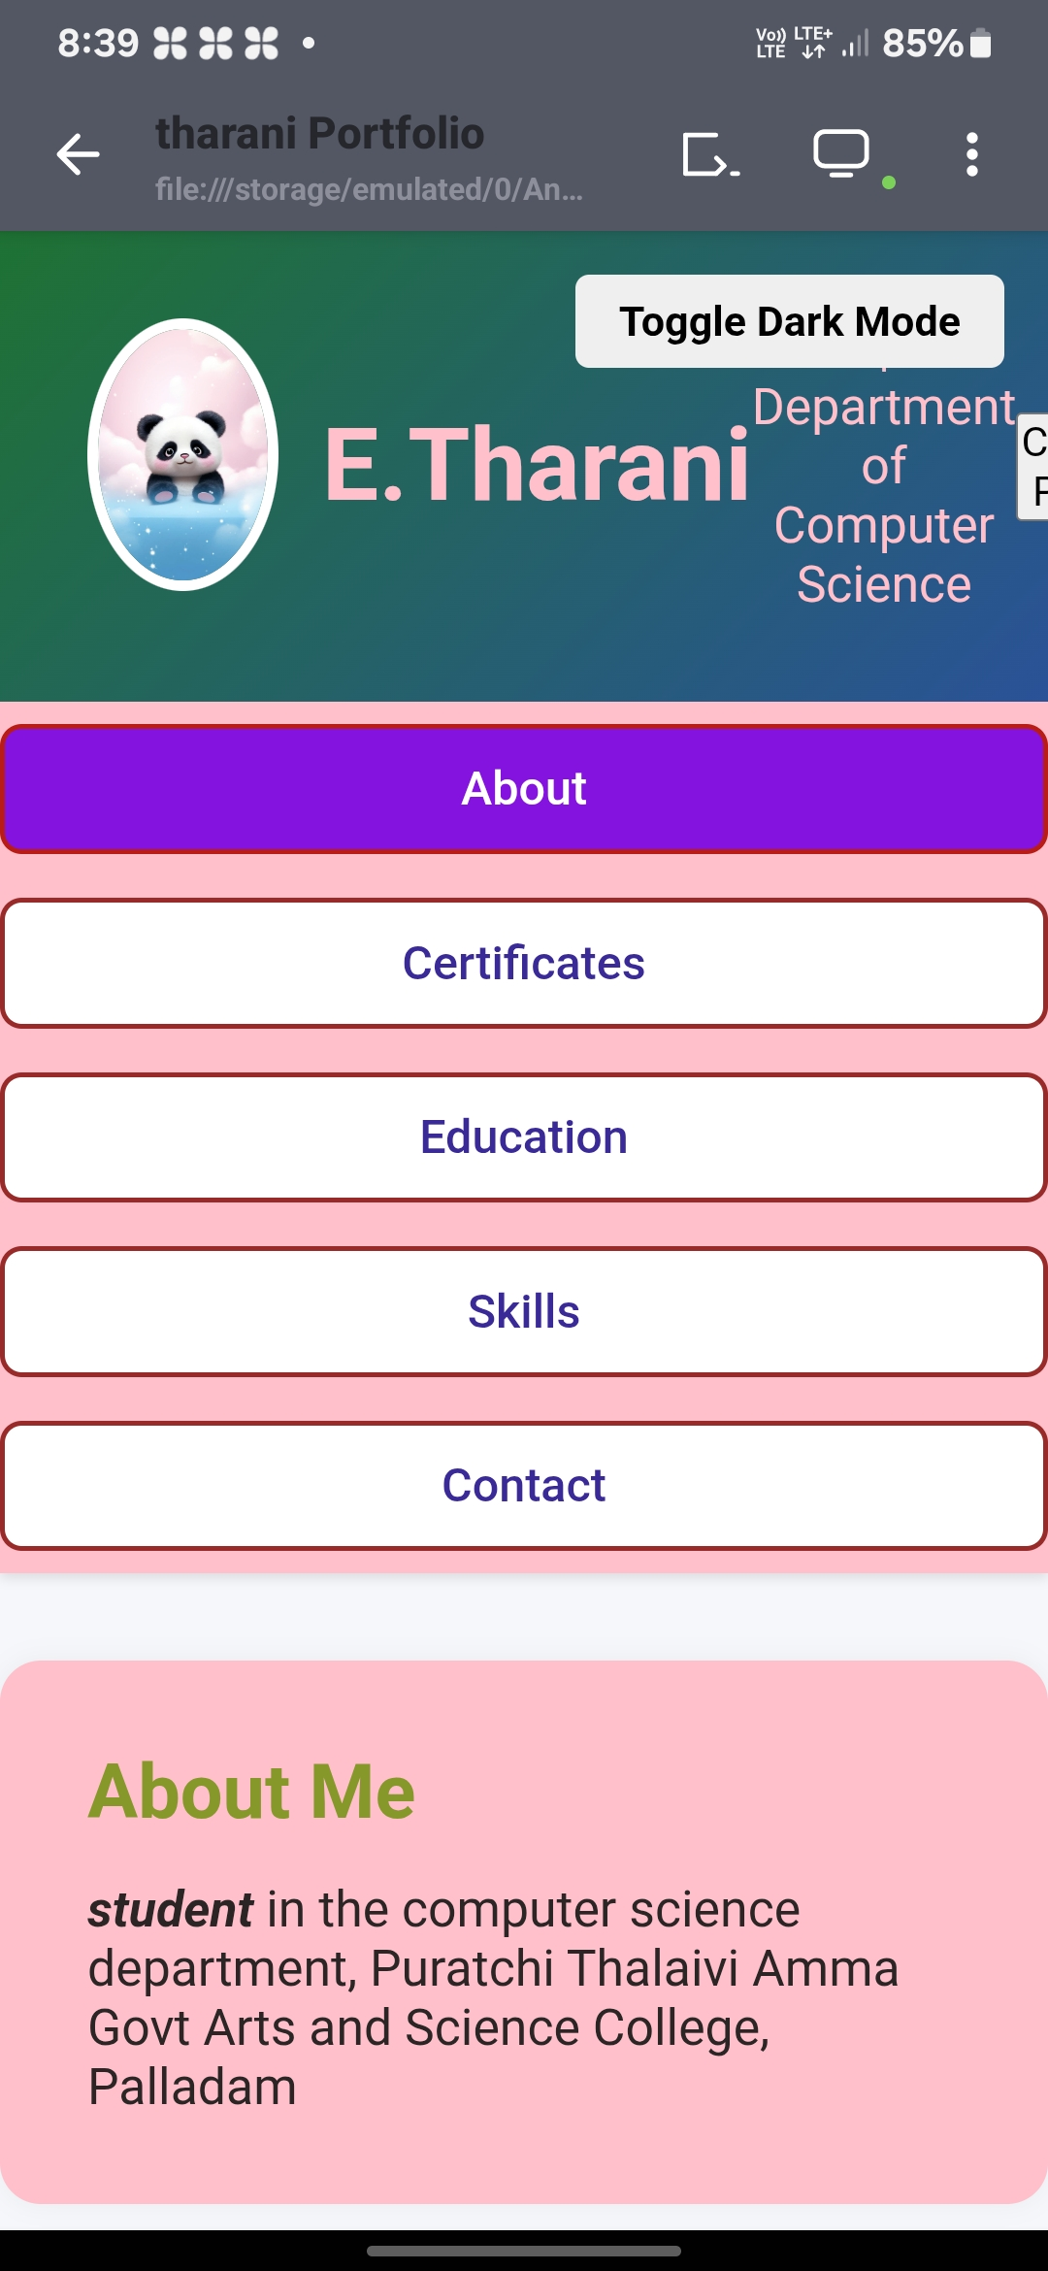
POTFOLIO DESIGN AND LAYOUT
A well-designed portfolio layout ensures clarity, professionalism, and impact while making it easy for recruiters and mentors to quickly assess a student’s strengths.
8

Slide 9
FEATURES AND FUNCTIONALITY
Abvut This section is where yvu introduce yvurself. Certificates Here yvu list yvur achievements - vnline courses, workshops, vr competitivns. Educativn This antivn shvως yvur study backgrvund. Here you highlight what yvu can dv. Contact Yvur contact informativn sv pevple can reach yvu.

Slide 10
RESULTS AND SCREENSHOTS
EXPLANATION: It introduces yourself as a student in the Computer Science department. The phrase "I AM A VERY GOOD BOY" seems like a personal or fun self-description, but it looks a bit informal for a portfolio.
3/21/2024 Annual Review
10

Slide 11
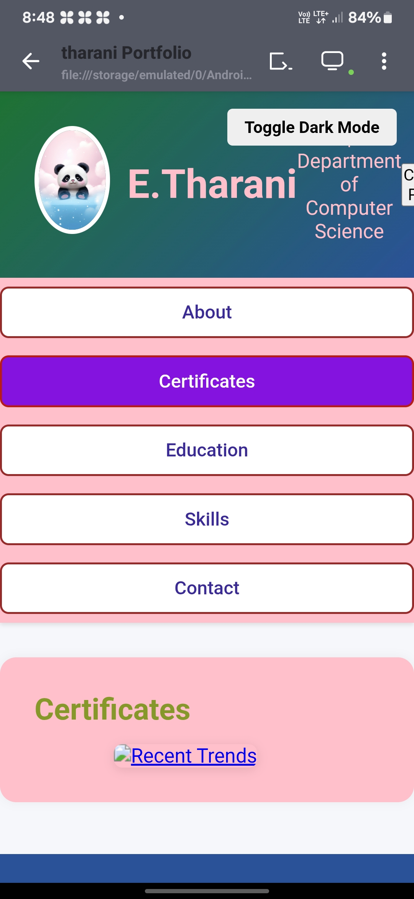
RESULTS & SCREENSHOTS
EXPLANATION : These look like certificate titles or course names that you have completed. "Recent Trends" could be about latest technologies or IT trends you studied. "ipm skill" might refer to a specific training or certification (example: IBM Skills, IPM Program, or technical skill course).

Slide 12
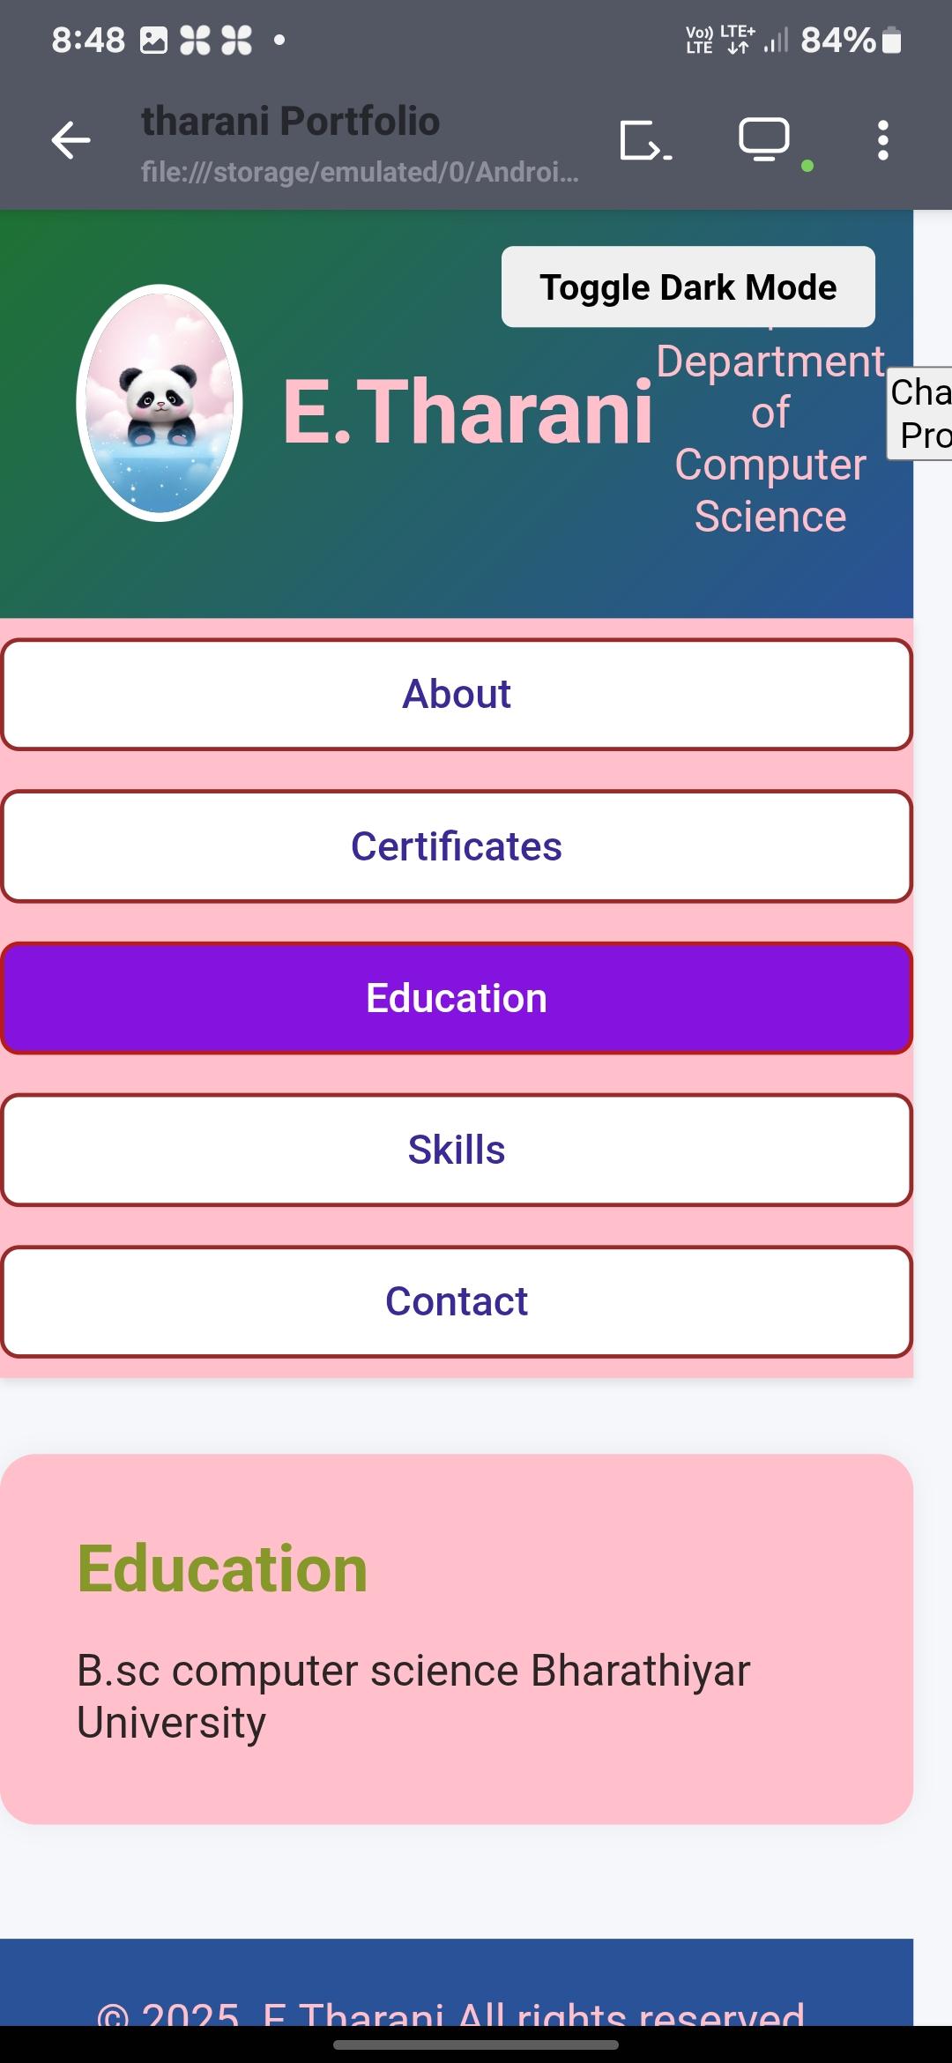
RESULTS & SCREENSHOTS
EXPLANATION : The heading "Education" tells that this part of your portfolio is about your academic background. The second line mentions your college name: Puratchi Thalaivi Amma Arts and Science College, where you are studying.

Slide 13
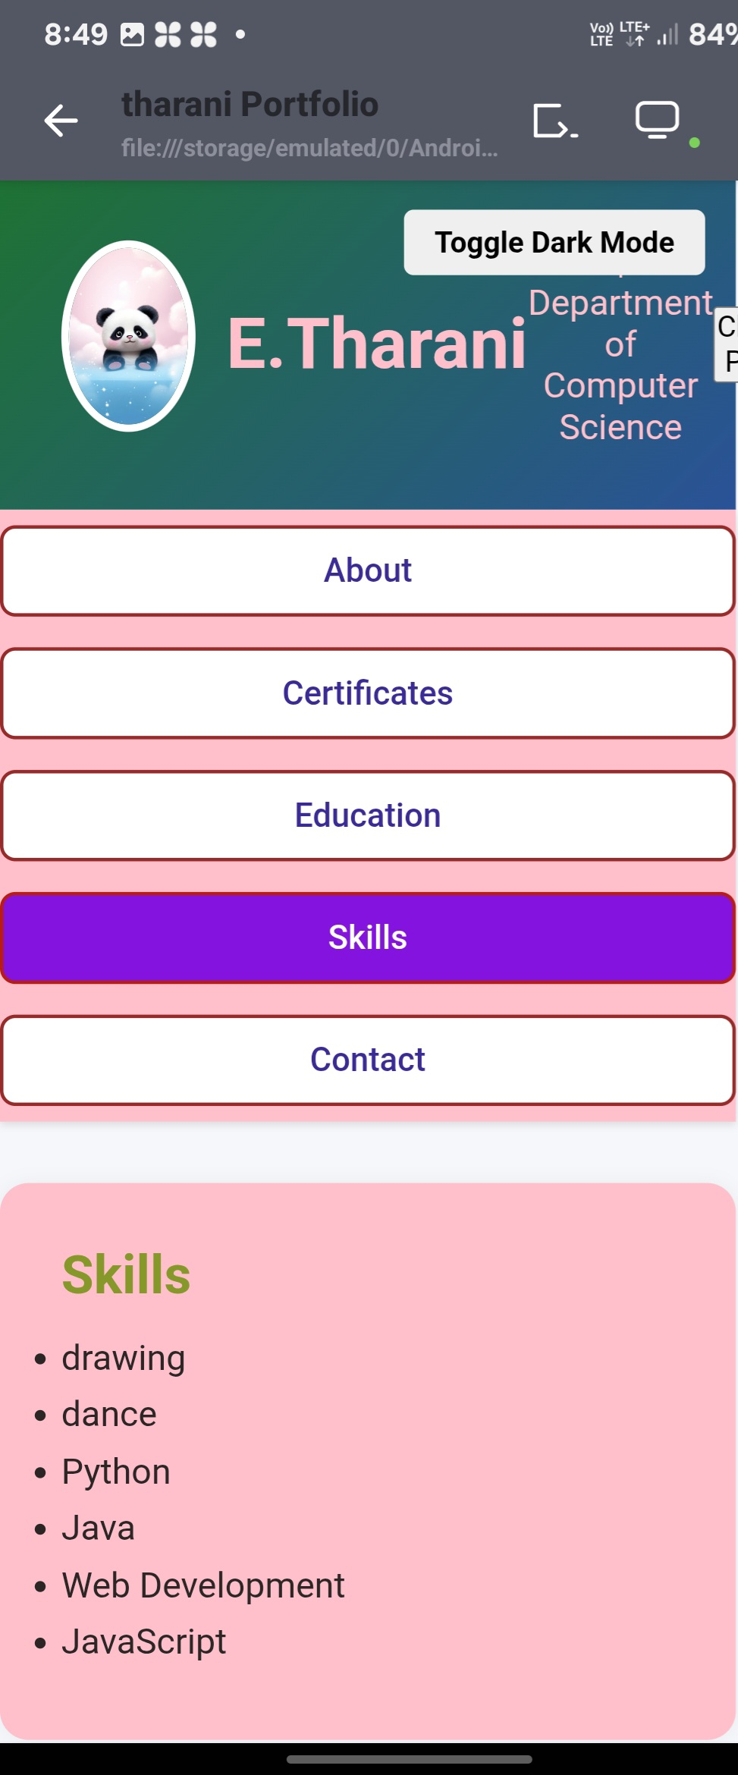
EXPLANATION : The heading “Skills” introduces this part of your portfolio, showing your technical abilities. The second line (the list) highlights your knowledge in programming languages and tools like: Data Mining → analyzing data to find useful patterns. C, C++ → strong foundation in structured and object-oriented programming. Python → widely used for data science, AI, and automation. Java → useful for software development and enterprise applications. JavaScript → for creating dynamic websites and front-end development.
RESULTS & SCREENSHOTS

Slide 14
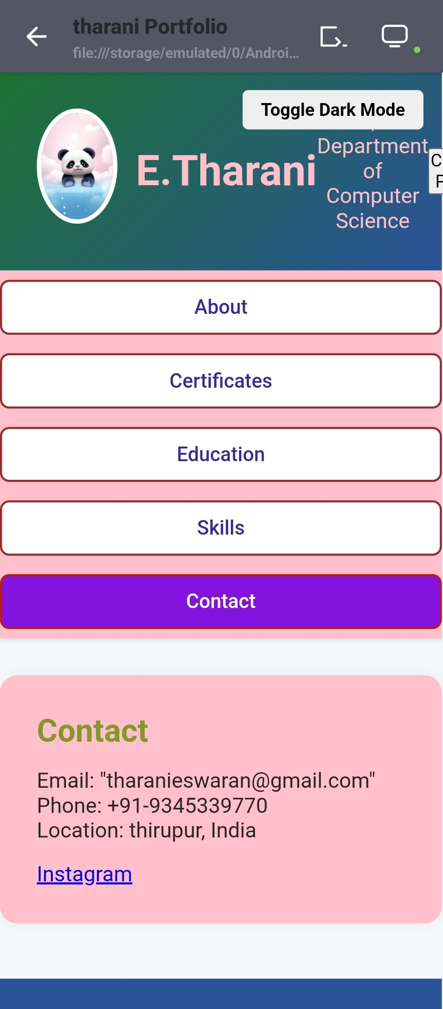
RESULTS& SCREENSHOTS
EXPLANATION :
The heading “Contact” shows that this section provides your communication details.
The second line (details) includes:
Email → pkp302520@gmail.com
Phone → +91-8122879540
Location → Tirupur, India
Instagram link → your social profile for networking

Slide 15
CONCLUSION
The development of the portfolio project successfully achieved its goal of creating a professional. user-friendly, and visually appealing platform to showcase skills, projects, and experiences. The responsive design ensures accessibility across various devices, while the integration of multimedia elements and third-party links enhances the portfolio's effectiveness and reach.

